Slide 1
Career Pathway - Software Development Engineer
Notes:
Hey there folks, hope you’re having a wonderful whatever time of day it is, and welcome to a short look on the fabulous life of a Software Development Engineer!

Slide 2
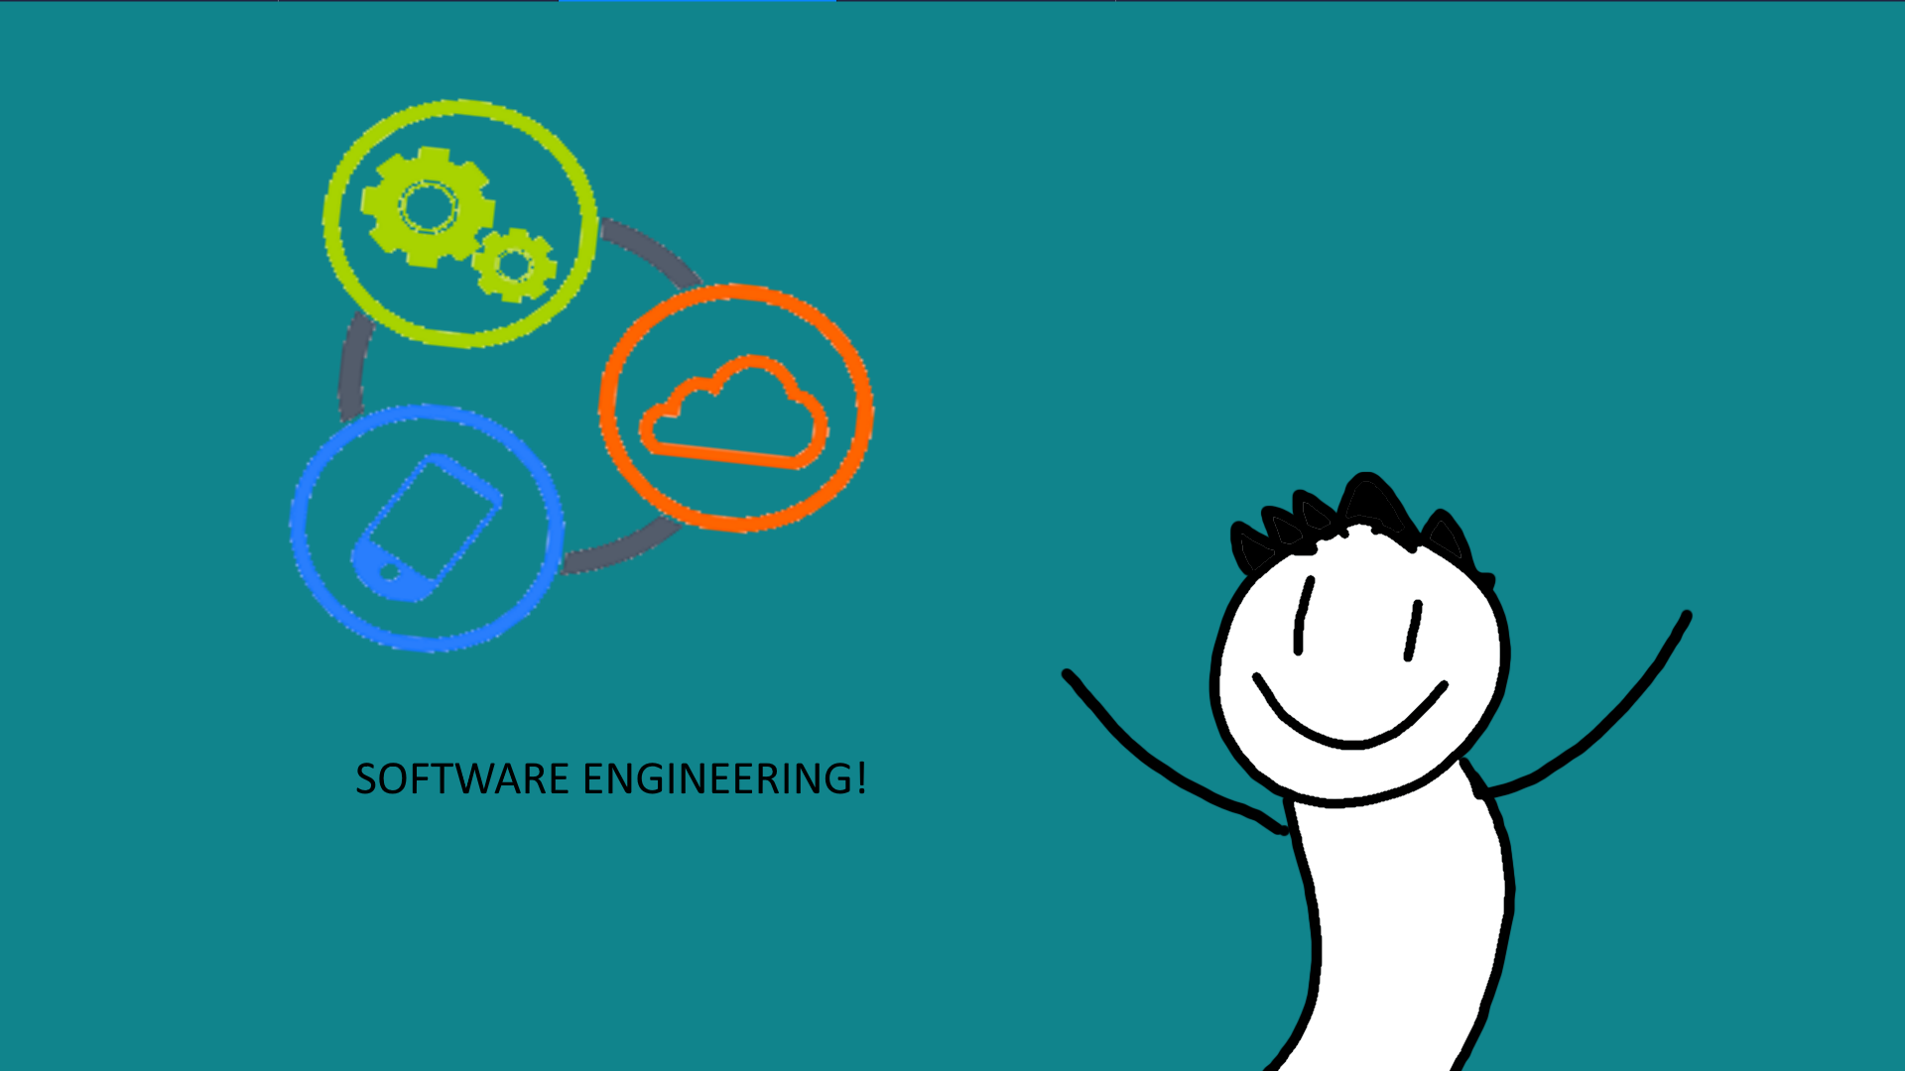
Notes:
My name’s Tanner, and I’ll be your guide through the process today!
We’re quite excited to have you, and even more excited for you to see all the wonderous facets of being a software engineer!

Slide 3

Agenda
Introduction to software development
Definition
Application
Notes:
But first, let’s provide somewhat of a roadmap for what we’ll be covering here today. First, I’d like to give us a short introduction in to what software development itself is. We’ll talk about it in a definitive sense, and we’ll also look into the application of developed software.

Slide 4
Agenda
Introduction to software development
Definition
Application
How to become a software development engineer
Skill set
Certifications
Degree requirement
Notes:
Next, we’ll look in to becoming a software development engineer yourself! We’ll discuss the different skill sets that employers look for in their engineers,
As well as different degree requirements and certifications that recruiters look for when hiring. We’ll further discuss in detail the types of certifications, and the knowledge base behind them, and what hard skills are needed for them.
Lastly, we’ll talk about the different types of undergraduate and graduate degrees that are relevant to the software engineering field.

Slide 5

Agenda
Introduction to software development
Definition
Application
How to become a software development engineer
Skill set
Certifications
example: AWS certification guide
Degree requirement
Career path for software development engineers
Companies that need software development engineers
Positions & Average salary
Advancement (promotion path)
Introducing the AWS product-- AWS mobile Hub
AWS mobile hub backend
6 key features
Our customers
Notes:
And then in our final section, we’ll discuss potential pathways for beginning your career as a software development engineer. We’ll underline some key corporations that are hiring engineers at this very moment, and the type of places you’ll find engineering work.
We’ll also briefly touch on the types of positions that software engineers hold when working for corporations--and also provide a look at the type of salary that these positions would make.
Lastly, because I’m sure you want to know where your life is headed in this career path, we’ll provide a sample of a typical promotion path for the average worker, and give an example of the amount of years it takes to progress to each position.
We’ll also briefly touch on Amazon Web Services and the mobile hub by talking about its mobile backend, its key features, and the kinds of customers it serves

Slide 6
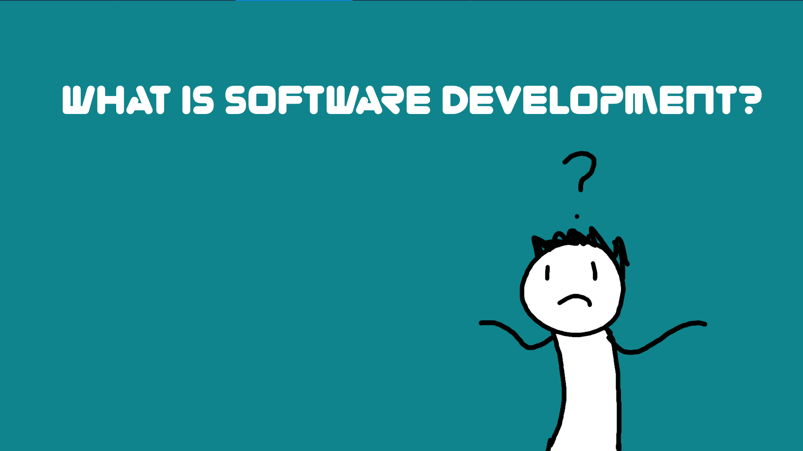
Notes:
But let’s start with the basics. Just what *is* software development?

Slide 7

Introduction
What is software development?
Notes:
Well, for starters, software development is something that a software engineer does!
Essentially, software development is a process by which standalone or individual software is created using a specific programming language.

Slide 8

What is software development?
Creating functionality behind developed software and UIs
Notes:
It becomes the role of the software engineer to create the functionality behind different programs that users would interact with. They may not be on the art side of things, but without good functionality, any program is useless!

Slide 9

Who is a software engineer?
Software Engineer = Person + Computer Engineering + Information Analysis + Computer Science + Design + Development
Notes:
Essentially, a software engineer combines computer engineering, information analysis, and computer design along with expectations for design and working with development teams in order to make a finished software product.

Slide 10
Software Development Engineer Classification
Front End
Back End
Ops
Test
Full Stack
Notes:
Furthermore, on the subject of working with development teams, a front-end developer links together the world of design and technology, packaging up the utility of the back end in an inviting way for users to interact with. They take website design files and convert them into HTML, JavaScript (JS) and/or CSS code - the core elements of front-end development.
back end refer to the separation of concerns between the presentation layer (front end), and the data access layer (back end) of a piece of software, or the physical infrastructure or hardware.
A DevOps engineer also works on computer applications, but manages the building, deployment and operation as a continuous automated process. DevOps engineers work with the operational side of a business and manage the workflow to integrate software to smoothly function with automated processes.
In Test, this kind of role is originated from Microsoft and currently many organizations are demanding such SDET professionals who can participate in development of the application and also in testing of the software developed.
A full stack developer is an engineer who can handle all the work of databases, servers, systems engineering, and clients. Depending on the project, what customers need may be a mobile stack, a Web stack, or a native application stack.

Slide 11
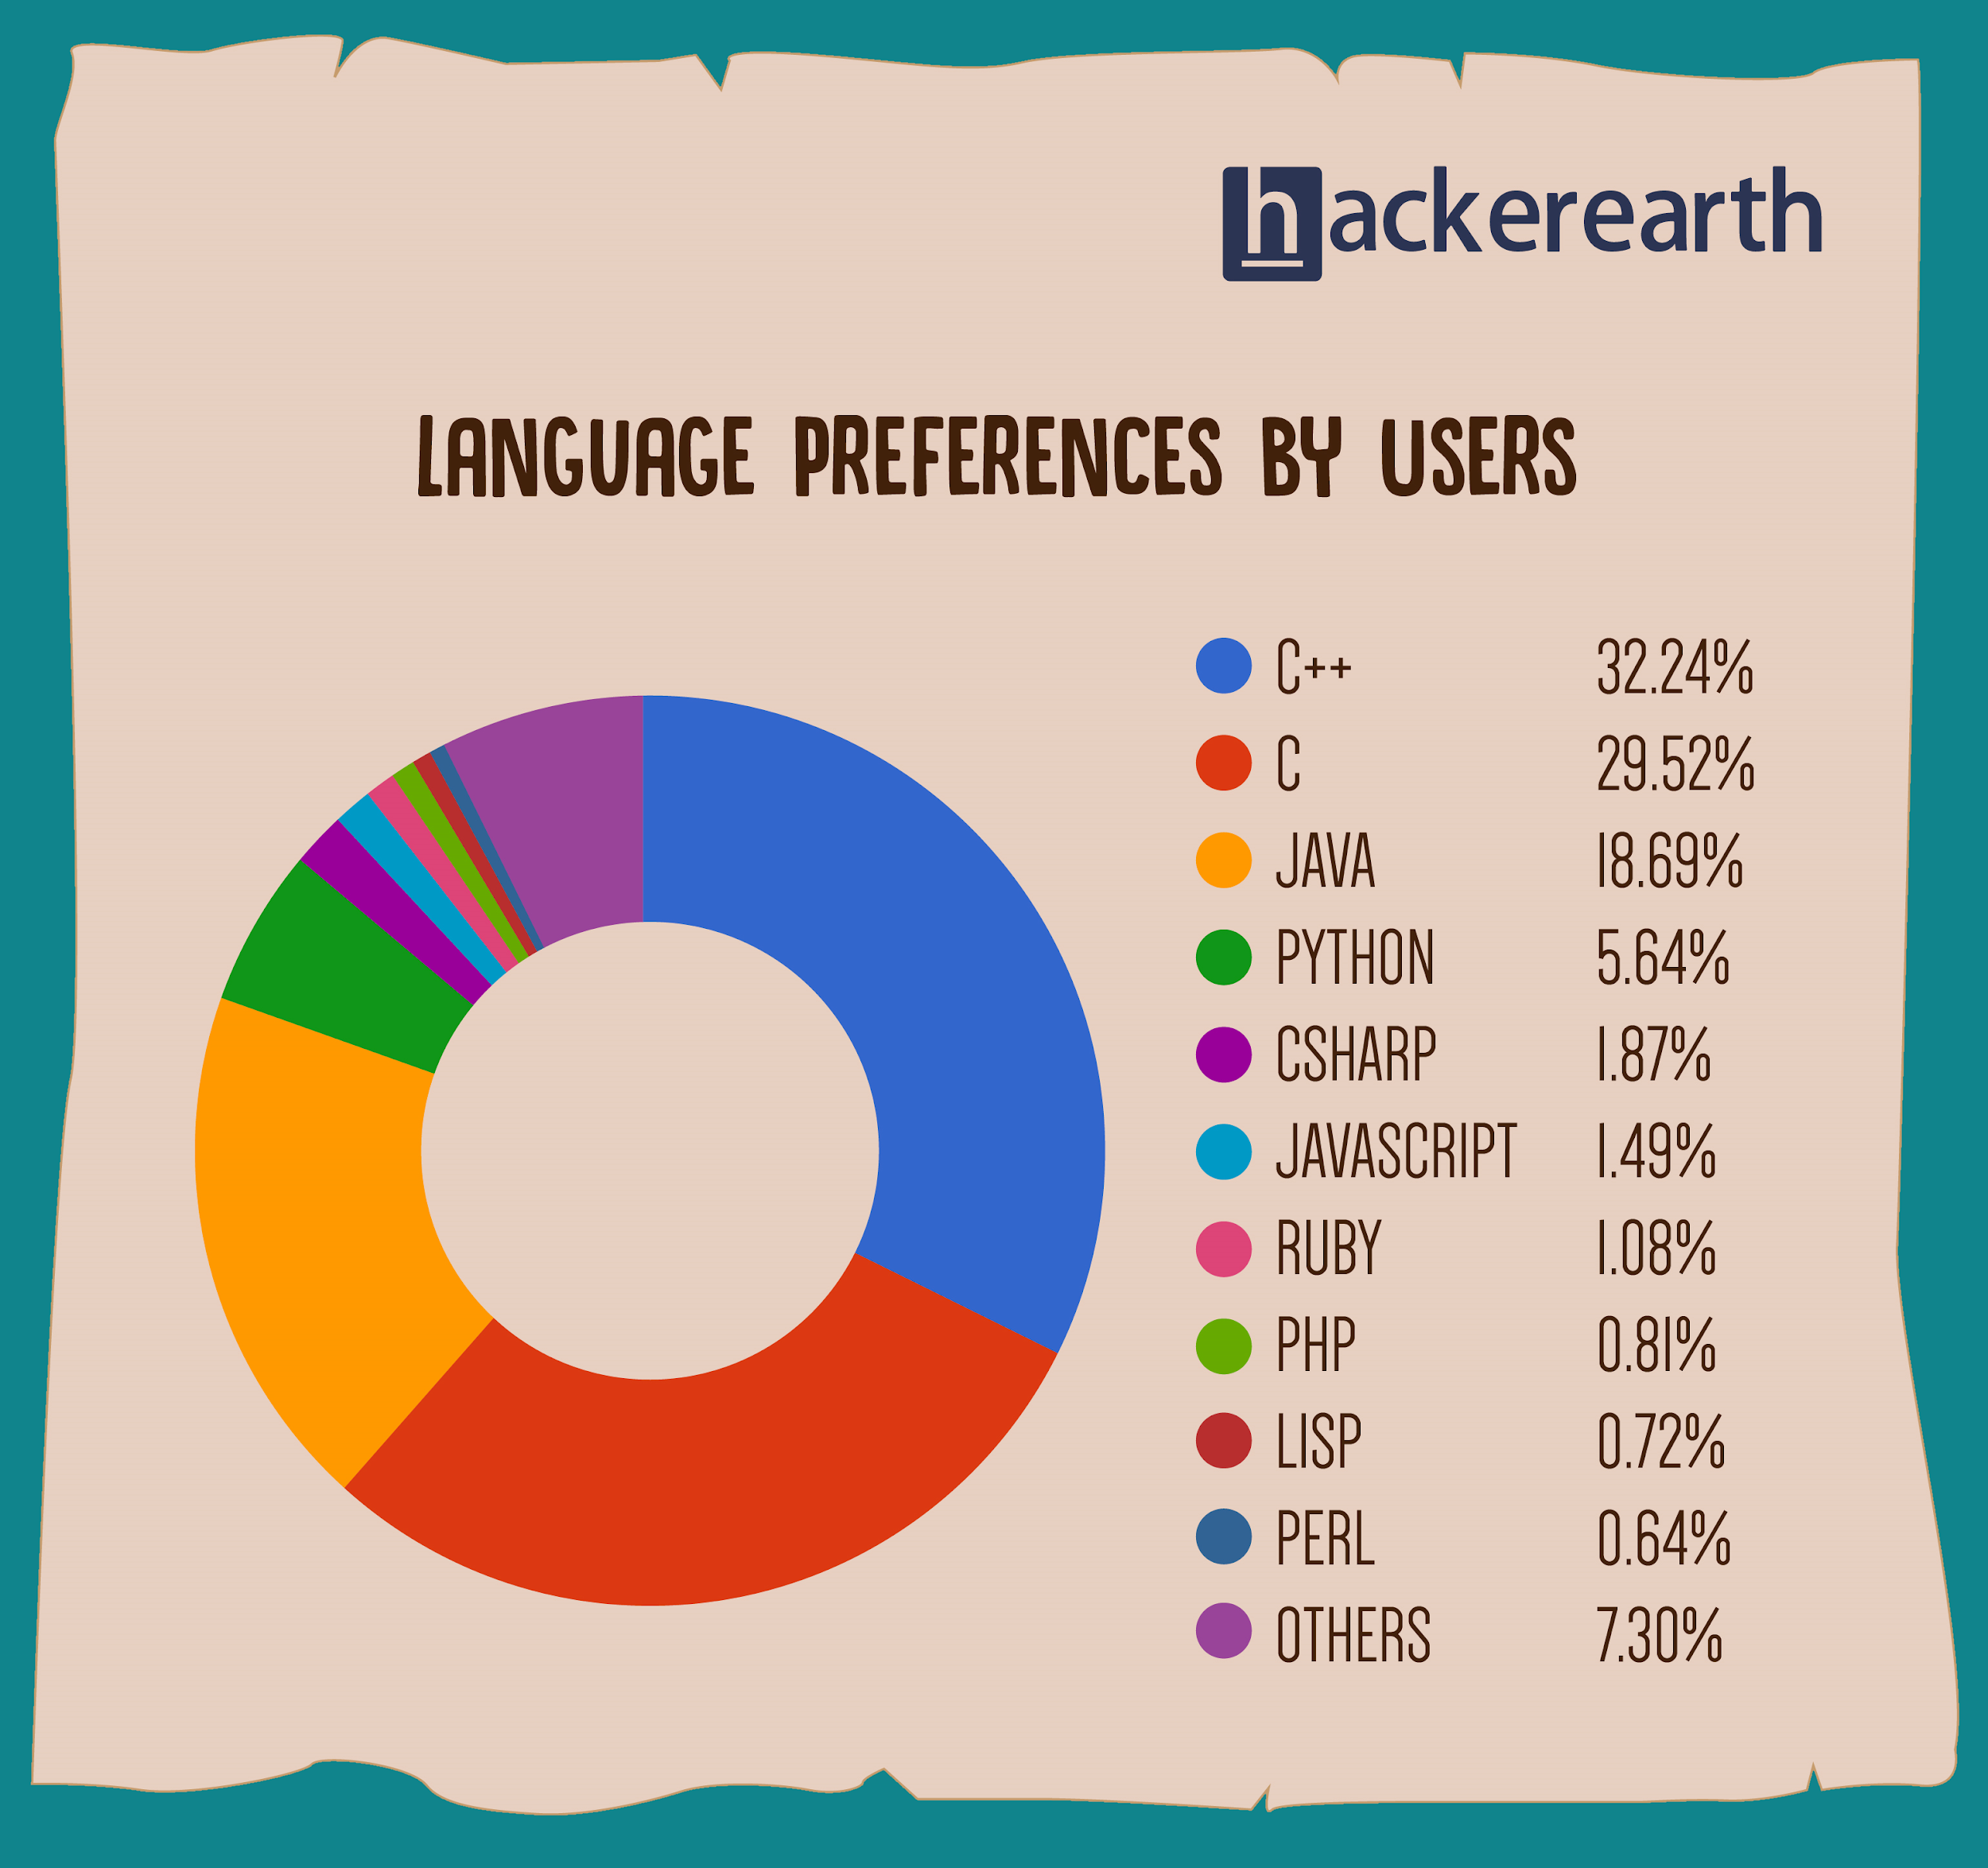
Related IDs - Programming Languages
Notes:
Related things that every software developer should know includes the utilization of different programming languages. While C dominates the market, Java and growing languages such as Python are rapidly expanding into the “need to know” category as the digital marketspace of ideas keeps evolving and grpowing.

Slide 12
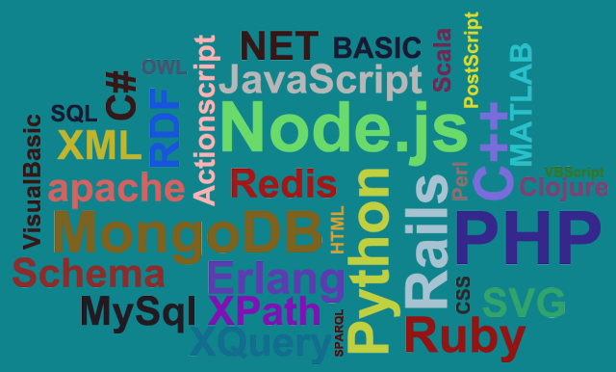
Related IDs - Scripting Languages
Notes:
Additionally, as different programming languages bloom, proficiencies in different scripting languages becomes more and more necessary. That being said, programming languages and scripting languages aren’t that different--Basically, all scripting languages are programming languages. The theoretical difference between the two is that scripting languages do not require the compilation step and are rather interpreted. For example, normally, a C program needs to be compiled before running whereas normally, a scripting language like JavaScript or PHP need not be compiled. Working knowledge of both types of languages will be necessary for all future software developers.

Slide 13
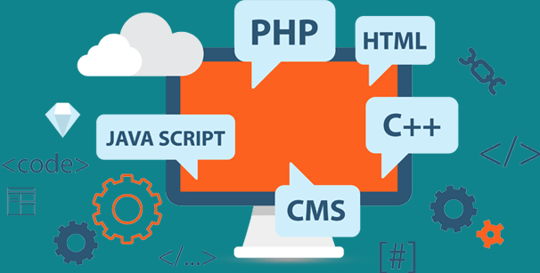
Related IDs - Web Development
Notes:
Lastly, web presence is an undeniably huge part of any corporation today. Web development itself is the machine that makes web-design work--which is basically to say that web development is the is the work behind developing a web site for the Internet or an intranet. Web development can range from developing a simple single static page of plain text to complex web-based internet applications, electronic businesses, and social network services, requiring increasingly complex ideas and materials.

Slide 14
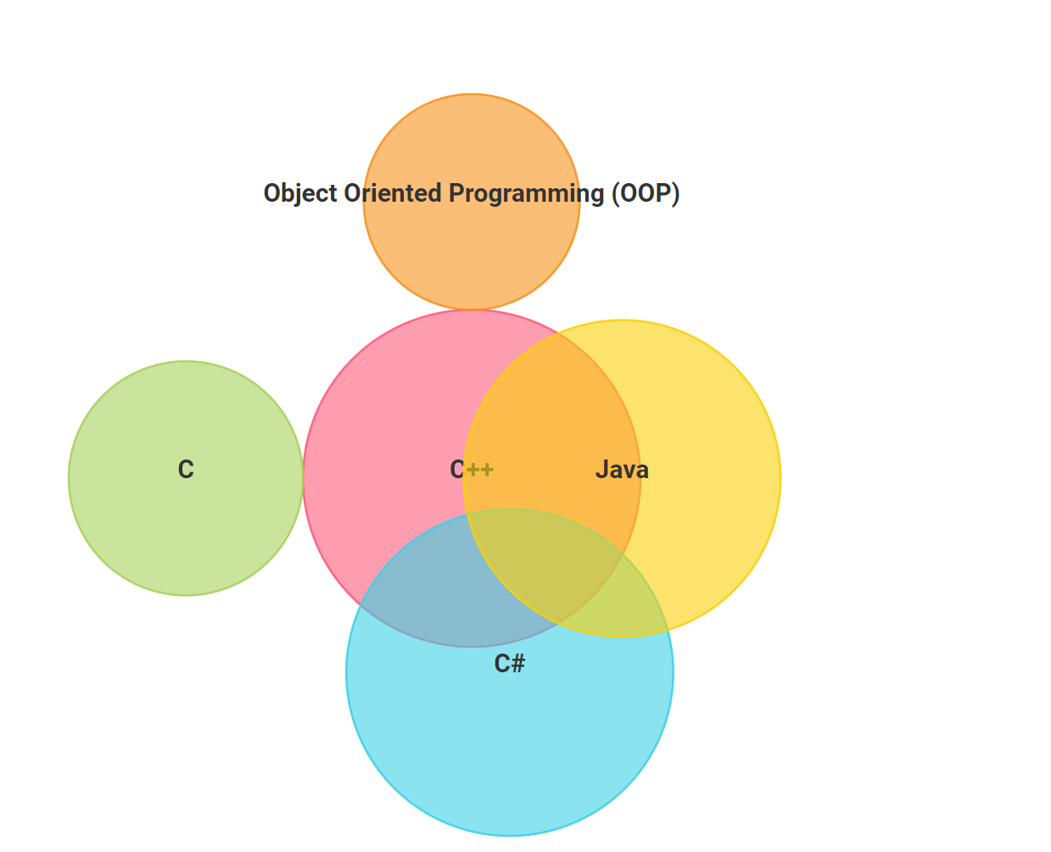
Popular skill set for software development engineers
Skill sets
C++, Java, Python, Ruby, Swift, etc...

Slide 15
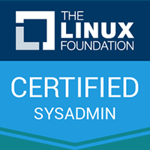
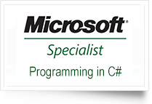
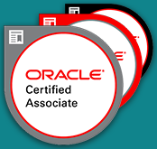
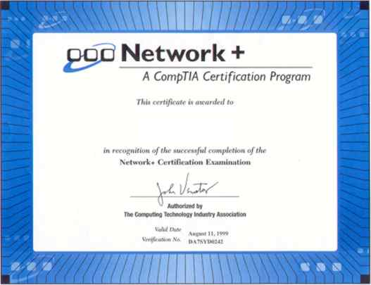
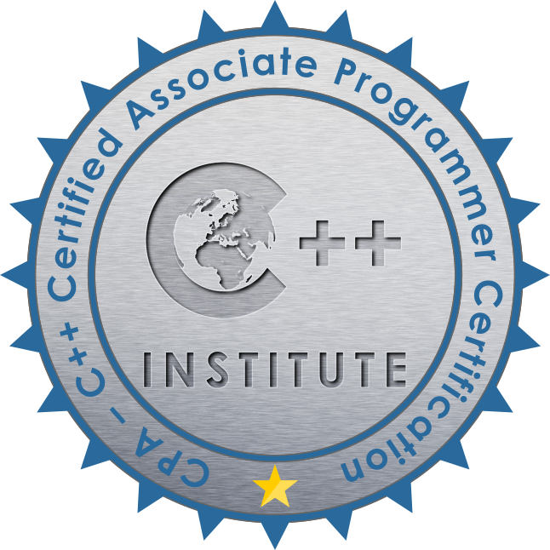
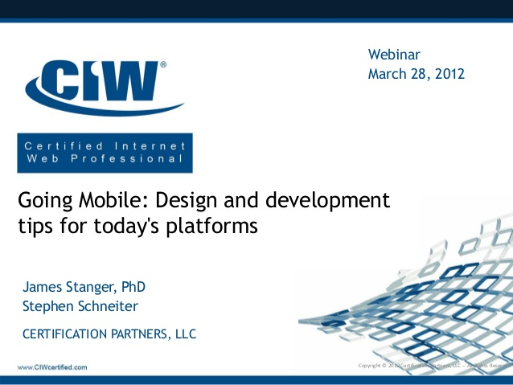
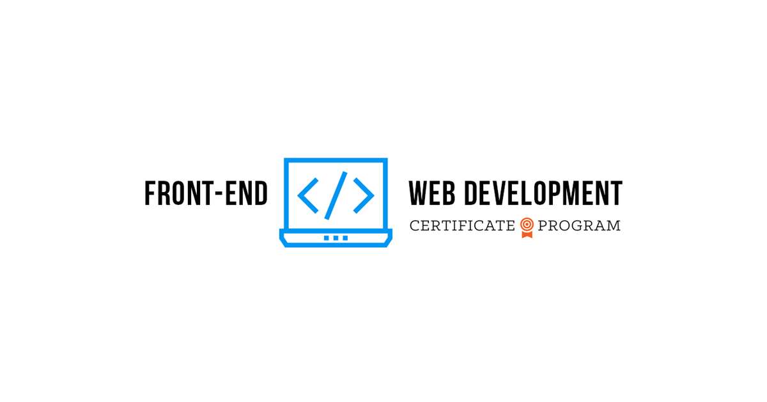

Certifications
Notes:
Oracle Certified Association(OCA): Java SE programmer
Oracle Certified Professional (OCP): Java SE programmer
Linux Administration Certificate
PHP Programming Certificate
Web Design Certificate
CIW Web & Mobile Design certificate
CIW Web Development Certificate
C ++ Programming Certificate
Visual C# Programming Certificate
Computer Networking Certificate
AWS certificate

Slide 16
Example - AWS Certification Guide
Amazon Web Services, or AWS, is a subsidiary of Amazon.
offers several services for cloud-based computing, storage and networking, the two most prominent being Amazon Elastic Compute Cloud (EC2) and Amazon Simple Storage Service (S3).
also provides database and analytics services, applications, developer tools, and much more.
Notes:
On top of all of the other certifications pictures, I’d like to introduce you to AWS.
Just read the slides after here

Slide 17
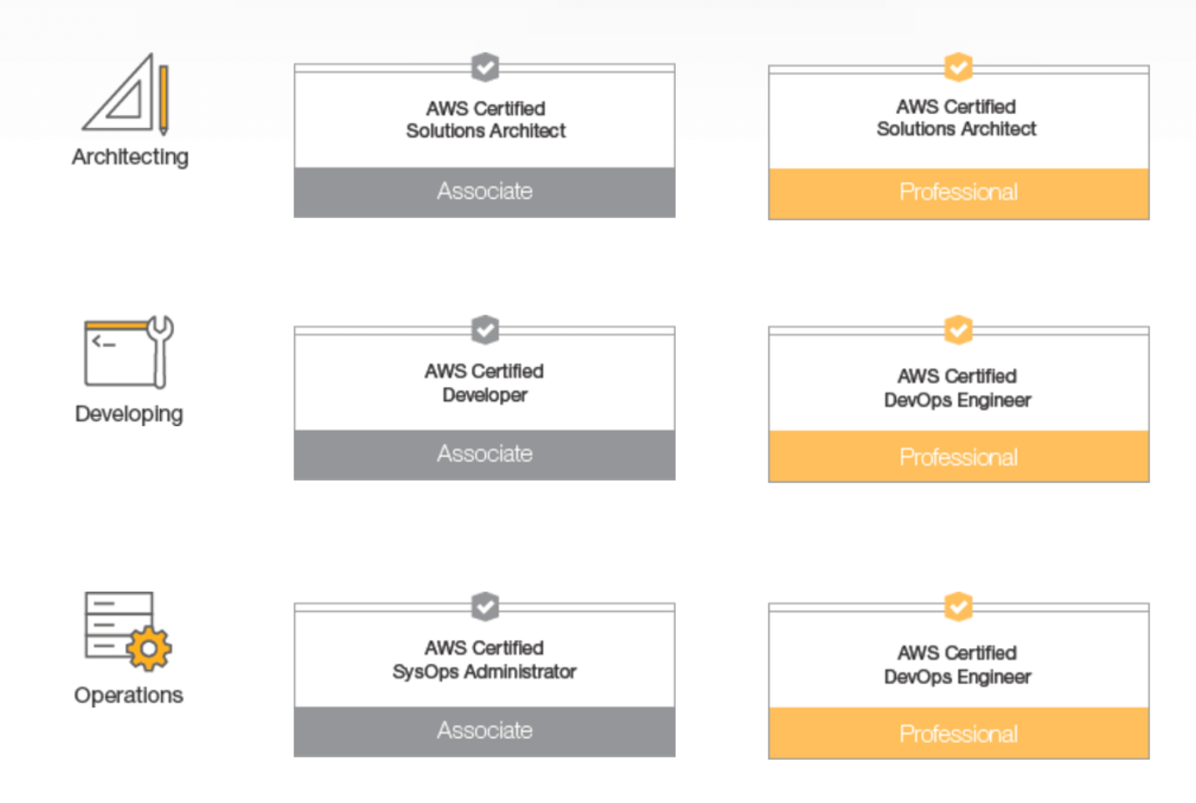
Example - AWS Certification Guide
Notes:
Considering that AWS practically owns the cloud space, the company's portfolio of certifications is surprisingly simple. AWS currently offers one foundation, three associate, two professional and three specialty certifications.
Architecting: These certifications recognize professionals who design and deploy distributed systems on the AWS platform. Candidates can start with the AWS Certified Solutions Architect – Associate and move up to Professional.
Developing: These certifications identify people who develop and maintain applications on AWS. The entry-level certification is the AWS Certified Developer – Associate, followed by the AWS Certified DevOps Engineer – Professional.
Operations: To support architecture and development, the AWS platform must be managed and optimized. The associate-level operations certification aims at system operators (SysOps) administrators. Because SysOps and DevOps are so tightly bound, this category includes the AWS Certified DevOps Engineer – Professional as the upper-level certification.

Slide 18
Example - AWS Certification Guide
Each certification requires candidates to pass a single exam with multiple-choice questions.
The foundation-level exam costs $100 and takes up to 90 minutes to complete, while associate-level exams take up to 130 minutes to complete and cost $150 ($20 for practice exams).
Professional-level and specialty exams are 170 minutes and cost $300.
To ensure that professionals keep their skills sharp and up to date, AWS requires credential holders to recertify every two years. That means taking the recertification exam for the certification you currently hold. Credential holders are eligible for a 50 percent discount voucher for recertification exams.

Slide 19











Degree & Curriculums
Bachelor, Master's degree in computer science, software engineering, computer information system, mathematics
Computer science
Computer programming Programming languages
Design & analysis of algorithms Cognitive modeling
Computer systems Artificial intelligence
Data structure and data management Machine learning
Program design, robotics laboratory Computer game design
Data management and information processing Math
Software engineer
Software engineering Computer architecture
Software design & construction Database designing
Software project management Programming languages
Software testing Networking
Verification and validation Math
Computer information systems
Computer information systems System analysis with UML,
Computer science, computer programming Networking fundamentals
C# programming, Security fundamentals
C++, Fundamentals of Linux
JAVA, Mechanics of web page design
Data structure and Algorithms Android programming
Spreadsheet applications
Mathematics
Calculus Topology and foundations
Linear algebra Geometry analysis
Probability and statistics Applied mathematics
Complex variables Math structure for computer
Notes:
https://www.learnhowtobecome.org/computer-careers/software-engineering/
Additionally, these are the types of schools and backgrounds that are associated with getting jobs in software engineering
software engineering associate degrees
database management systems
web application development
operating systems
networking
software engineering bachelor’s degrees
object-oriented software development
computer security
project management
user interface
software engineering master’s degree
mathematical modeling
software design
software testing
software system architecture
software engineering phD degree
software modeling and design
economics of software engineering
software engineering for the internet
experimentation in software engineering

Slide 20
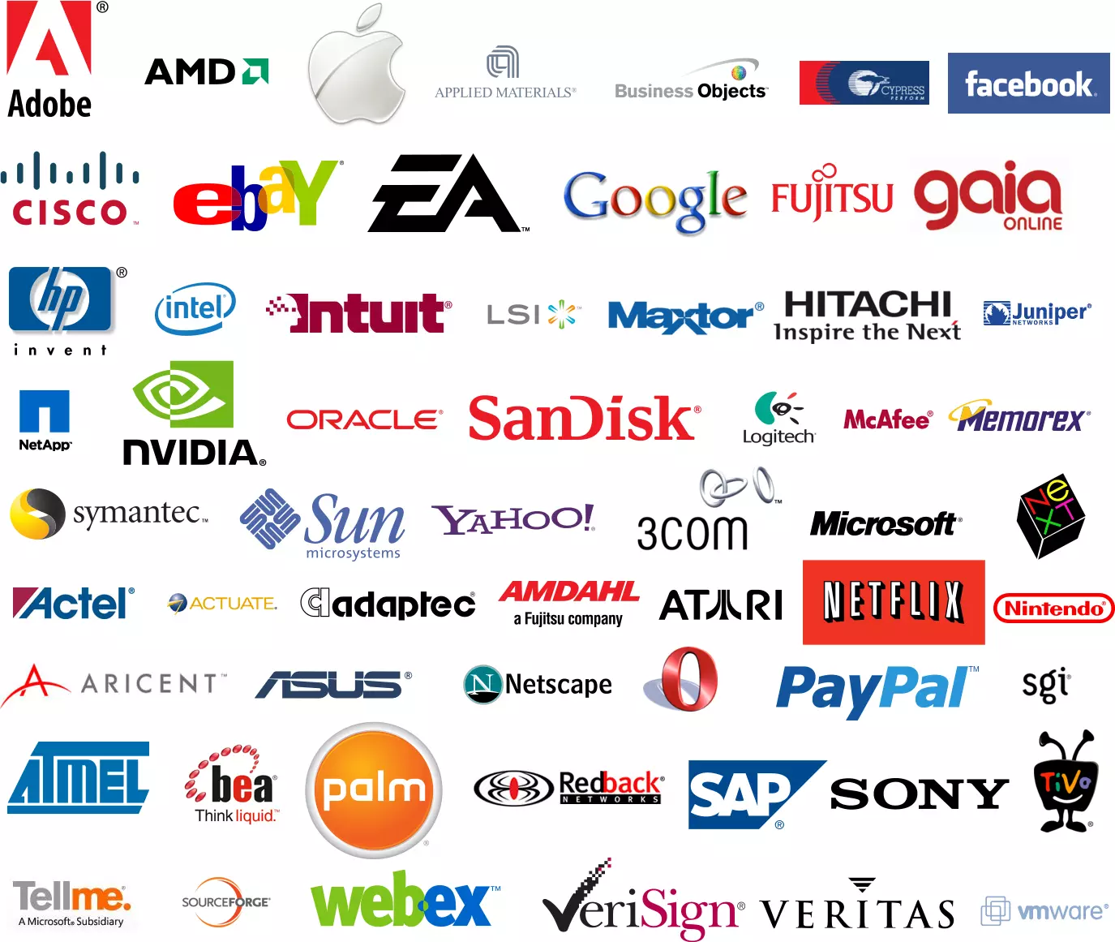
Career
Notes:
And lookey here! Lots of sexy, sexy companies and corporations have distinct needs for software engineers. Silicon Valley in particular and other tech bases in the United States are looking for positions of:
software developer, database administrator, computer hardware engineer,computer systems analyst, computer network architect, web developer, information security analyst, computer and information research scientists, computer and information systems managers, IT project manager

Slide 21
Career Outlook & Advancement
Career Field
Systems development
Develop operating systems for computers
Applications development
Design computer programs and modify existing programs to perform specific tasks
Career path
4~5 years
senior technical project manager
2~3 years
lead developer
2~3 years
software architect
software developer
Notes:
Finally, I’d like to talk about the career outlook of a software development engineer.
Today, software accounts for 19% of the IT market in US.
Software developer will see an employment growth of 14% from 2014-2024, while application developers will see growth of 19% during the same time.
the most in-demand software engineering skill is currently mobile application development because of exploding growth in mobile networks, phones.
The duration will depends on what is your current position. Moving from one position to the next level position will at-least take 2 to 3 years in almost all organizations.

Slide 22
Career Outlook
On average
$114,125/Yr
Entry level (0~5 years) | $104,000/Yr
Mid-career (5~10 years) | $122,000/Yr
Experienced (10~20) years | $123,000/Yr
Late career (>=20 years) | $100,000/Yr
Average pay by experience level
Palo Alto | $134,771/Yr
Sunnyvale | $121,851/Yr
Irvine | $122,511/Yr
Redmond | $118,326/Yr
San Jose | $117,504/Yr
Average pay by location
Notes:
Lastly, especially if you’re looking at the job itself, it’d be nice to know exactly what you’re getting into salary wise.
Fortunately for you, prospects look good! The average salary is well above $100,000 a year which is pretty incredible. Particularly in California, software engineers, while they have a lot demanded out of them, have a very high pay in many desireable locations in California.

Slide 23

AWS Mobile Hub
Mobile backend:
User Identity
Push Notifications
Content Data, Media,Files
Analytics
Application Logic
On-Device Testing
Notes:
Mobile app development is complex and time-consuming. AWS Mobile Hub simplifies the process of building, testing, and monitoring mobile applications that make use of a range of AWS services. There are many resources available to help you build your next app in the cloud.
Many of the main aspects of computer software development easily transfer over to mobile development, which is, as you know, an incredible fertile field at the moment.

Slide 24
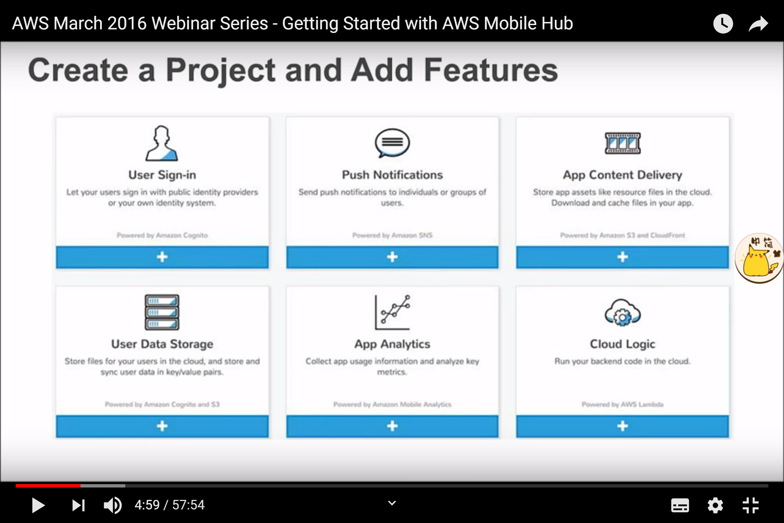
Key features of AWS Mobile Hub to build your own application
Notes:
the hub will create a project for you based on what features you choose. it is a dynamically generated application tailored to your own preference.
the beauty of this application is when you download the automatic app that mobile hub generated. the choices you made bring the production level real example code developed by AWS engineers. Therefore, you can run and see how that feature work.

Slide 25
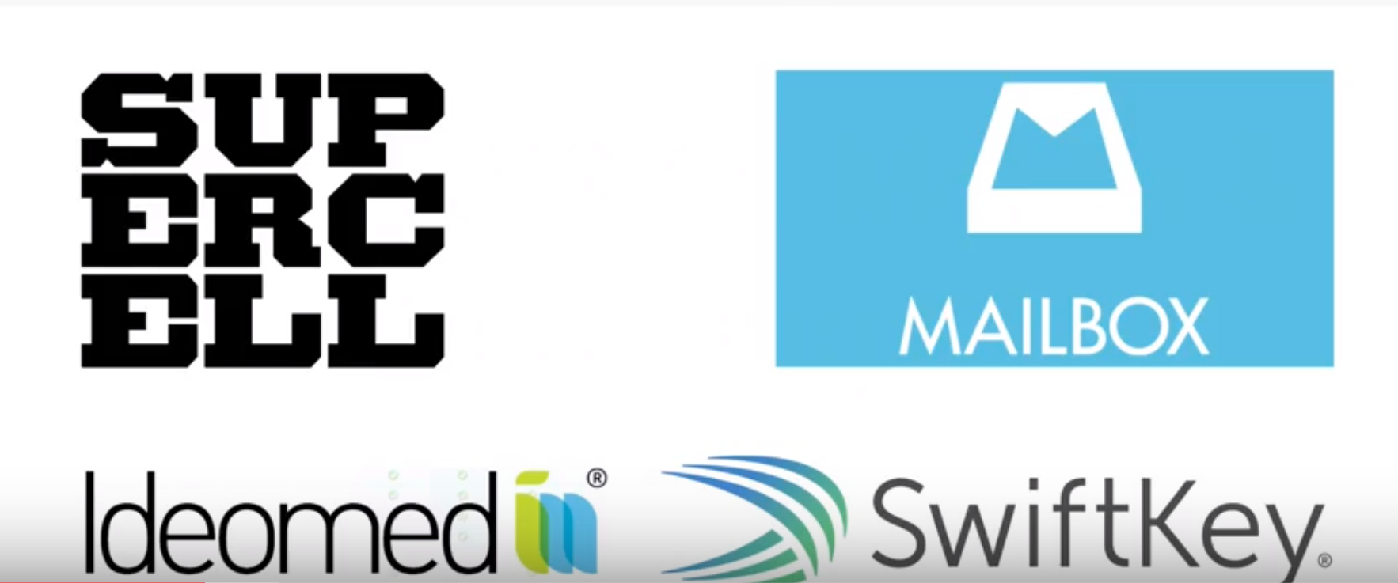
Customers Using AWS for Social & Mobile Applications
Notes:
super cell: using aws to help them scale analytics and delivery those applications. majority of its backend information was build on AWS cloud.
company background:Supercell is a mobile game developer.Their goal is to make the best games – games that are played by as many people as possible, enjoyed for years and remembered forever.
MailBox: categorize and manage your mail more effectively by using aws applications.

Slide 26
Career Pathway – In-class activity
Notes:
Hey there folks, hope you’re having a wonderful whatever time of day it is, and welcome to a short look on the fabulous life of a Software Development Engineer!

Slide 27
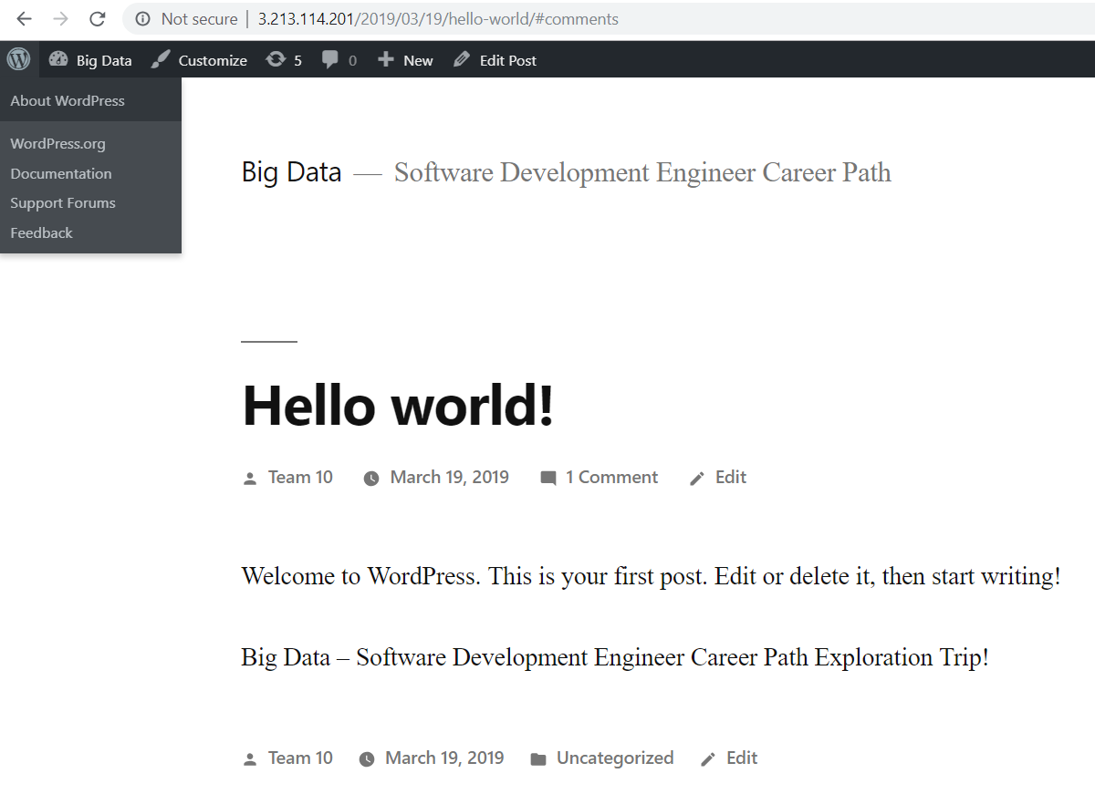
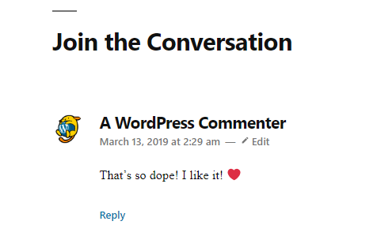
In class activity
Starting Point of Software Development Engineer
Building your own website using EC2& Route 53
•Step 1: Launch an Amazon EC2 Instance
•Step 2: Configure your Instance
•Step 3: Make Changes to Your Website ($0)
Register a Domain Name with Amazon Route 53
•Step 1: Obtain a Static URL ($0 or $0.005/h)
•Step 2: Register a Domain Name (.com $12)
•Step 3: Configure DNS

Slide 28
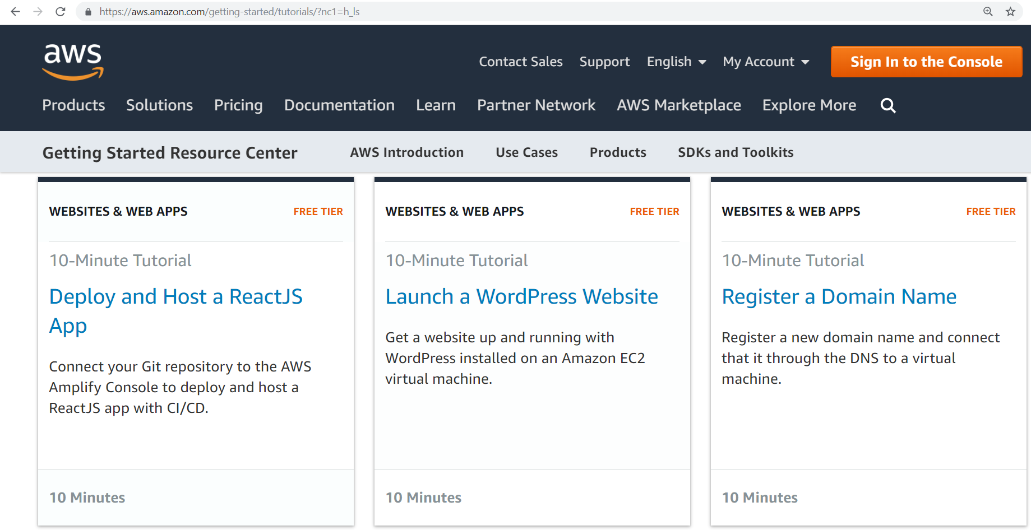
Building Your Own Website - hint
https://aws.amazon.com/getting-started/tutorials/?nc1=h_ls

Slide 29
Building Your Own Website
Launch a WordPress Website with Amazon EC2
•Step 1: Launch an Amazon EC2 Instance
•Step 2: Configure your Instance
•Step 3: Make Changes to Your Website ($0)
Register a Domain Name with Amazon Route 53
•Step 1: Obtain a Static URL ($0 or $0.005/h)
•Step 2: Register a Domain Name (.com $12)
•Step 3: Configure DNS

Slide 30
Building Your Own Website
Launch a WordPress Website with Amazon EC2
•Step 1: Launch an Amazon EC2 Instance
•Step 2: Configure your Instance
•a. AWS Marketplace - WordPress
•b. detailed pricing page
•c. free-tier eligible t2.micro instance
•d. We will set a name for your instance
•e. start your Amazon EC2 instance running WordPress
•f. proceed without a key pair
•g. view Instances
•h. test WordPress website and see a Hello World blog page appear
•Step 3: Make Changes to Your Website
•a. EC2 management console-Actions-Instance Setting-Get System Log
•b. find the password that's surrounded by hash marks
•c. access the WordPress Hello World admin page and manage your Website ($0)

Slide 31
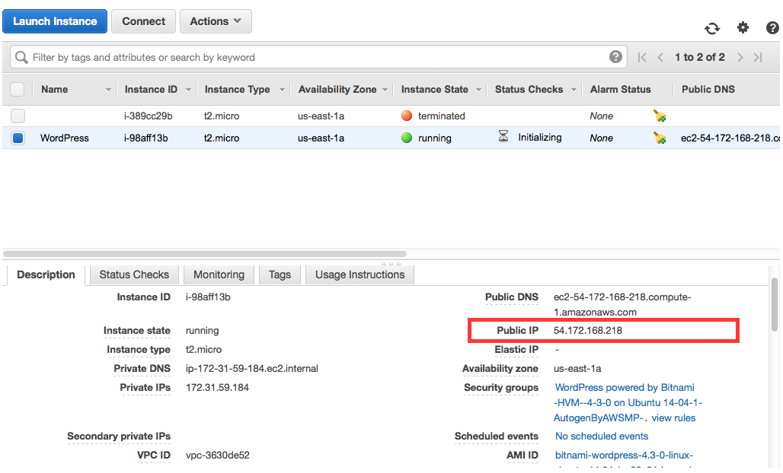
Building Your Own Website
Amazon EC2

Slide 32
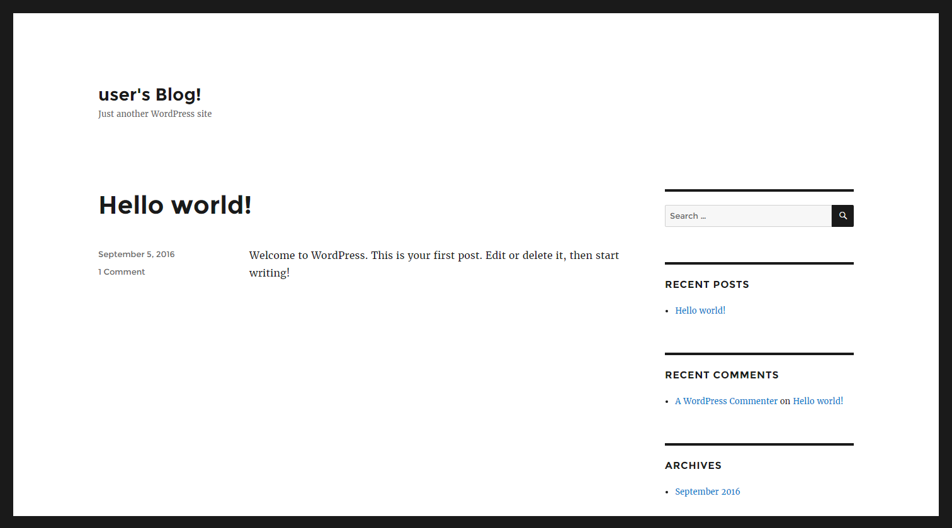
Building Your Own Website
WordPress

Slide 33
Building Your Own Website
Register a Domain Name with Amazon Route 53
•Step 1: Obtain a Static URL ($0 or $0.005/h)
•a. open the Elastic IPs part of the EC2 console
•b. Set EIP used in: to VPC and click Yes, Allocate
•c. Note your new IP address
•d. Select the new IP address with the Associate Address option
•e. Instance text box and choose instance name
•f. Verify that your new Elastic IP address is working
•Step 2: Register a Domain Name (.com $12)
•a. open the Route 53 console (AWS’s DNS service)
•b. Register Domain button
•c. Enter your Contact Details
•d. Complete purchase
•Step 3: Configure DNS

Slide 34
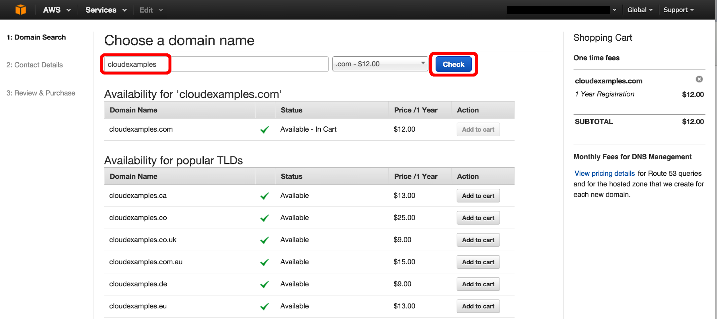
Building Your Own Website
Amazon Route 53

Slide 35
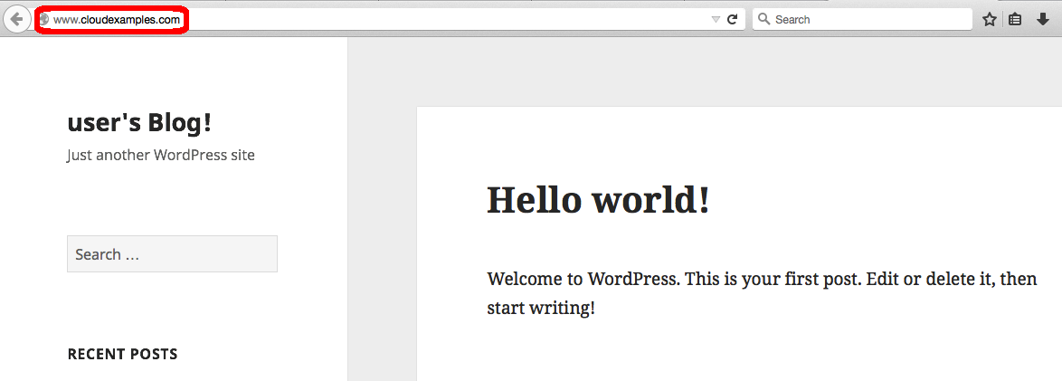
Building Your Own Website
WordPress

Slide 36

Thanks for watching!
Your Link can be put here☺
Career Pathway - Software Development Engineer https://XXXXXX
Notes:
Thanks for watching, and now we’re going to lead into a short exercise that will help you showcase skills to employers on your journey of becoming a software developer!

